Slide 1

On Large-Batch Training for Deep Learning: Generalization Gap & Sharp Minima
PRESENTED BY: AUJASVI
MASTER STUDENT-DATA SCIENCE

Slide 2
Contents
Objective of the Paper
Introduction
Problem statement
Drawbacks of Large-Batch Methods
Experiments
Success of Small-Batch Methods
Conclusion

Slide 3
Objective of the paper
The authors provide numerical evidence that supports:
In Deep learning tasks, while using SGD (stochastic gradient decent & it’s variants) large-batch methods (ex. 10,000 data points) tend to converge sharper minimizers of training and testing functions leading to poor generalizations
Degradation in the quality of the model
Discuss several imperial strategies to reduce this gap

Slide 4
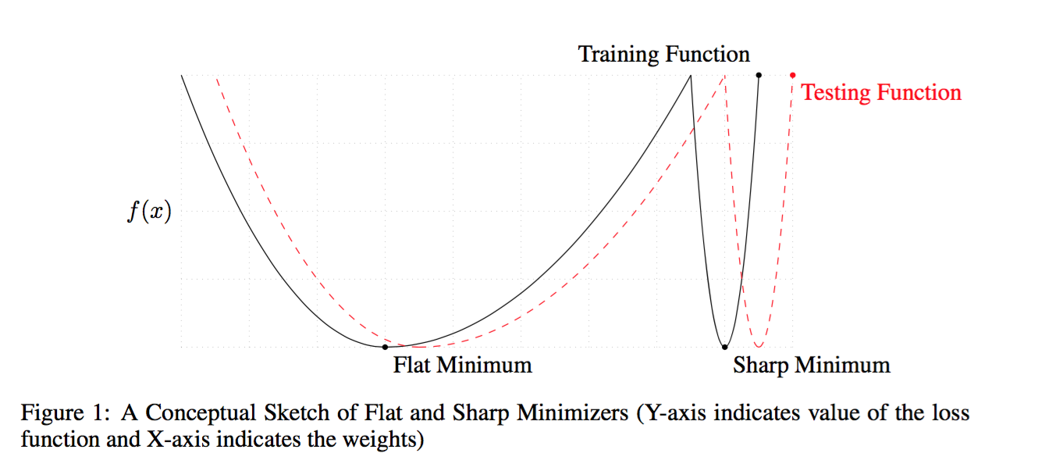
Contd.

Slide 5
Introduction
The goal of the neural network is to find is to find best parameters W and minimize the loss function f
Iterative refinement, continuously update the set of weights
Achieved by Stochastic Gradient descent (SGD) or Mini–batch Gradient descent (MGD)-256 training example
Reduce noise in the parameter update
More stable convergence

Slide 6
Problem Statement
Why Does an increase in the batch size creates a higher generalization gaps ?
This is question the authors shed light upon

Slide 7
Drawbacks of Large-Batch Methods
LB methods overfit the model
LB attracts to the saddle points
LB lack the explorative properties of SB methods & tend to zoom-in on the minimizer closest to the initial point
SB and LB methods converge to qualitatively different minimizers with differing generalization properties

Slide 8
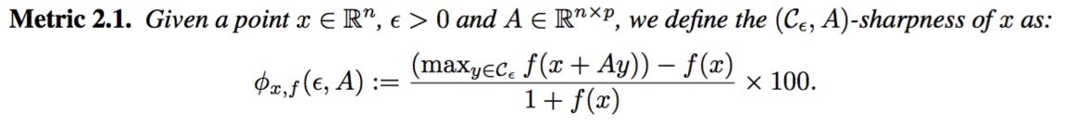
Experiments
Parametric 1D plots (https://arxiv.org/abs/1412.6544) by Goodfellow et.al for virtualization
Metric of sharpness
LB uses 10% training data for the batch size & SB uses 256 samples

Slide 9
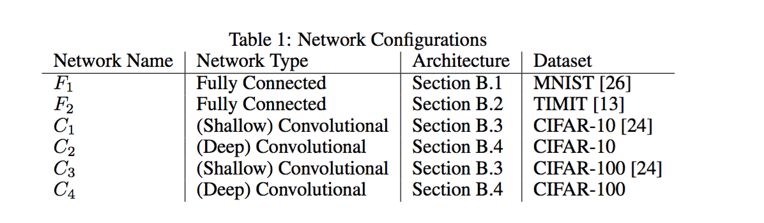
Contd.
Models : 6 different network architectures
Adam update rule: Improvement of the basic stochastic gradient descent

Slide 10
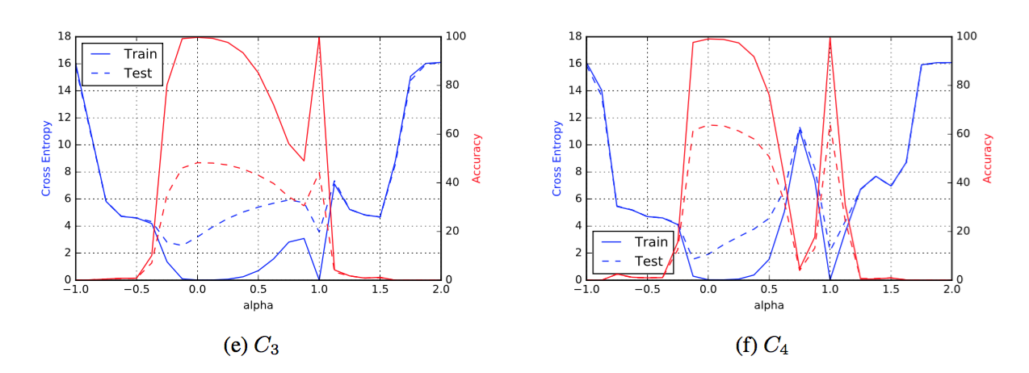
Contd.
Shallow Convolution c3 & Deep Convolution C4 (Curved path)
Legend:
Left axis is cross-entropy loss, right axis is classification accuracy
Solid line is training data set, dashed line is testing data set
Alpha = 0 corresponds to the SB minimizer, alpha = 1 corresponds to the LB minimizer
Observation : LB minima are strikingly sharper than the SB minima in the 1D manifold

Slide 11
Success of small batches
According to the authors:
SB method gradient are nosier than their LB counterparts
Pushes the iterate out of minimizer basin and pull it towards flat minimizer
If initial noise is smaller, then it will stay in the minimizer basin
Piggybacking LB on SB (Important result)
Using iterates trained with SB gradient descents and warm starting LB methods with them
Authors are able to show, after the certain threshold sharpness of LB iterates drops

Slide 12
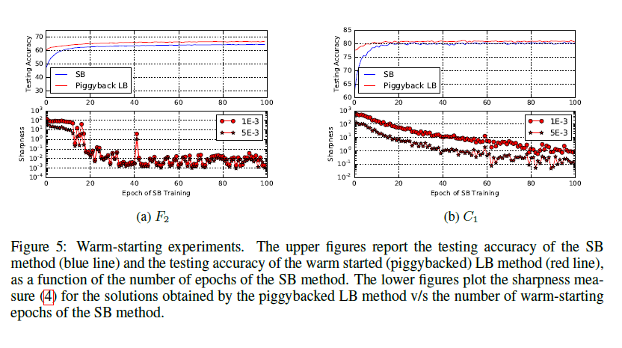
Contd.
LB has used the power of exploration of SB and landed in the flat minimizer

Slide 13
Conclusion
By providing evidence that the “sharpness” measured in 1-D parametric plots of multiple deep learning architectures increases with larger batches, the author were able to show sharp minimizers do cause a deterioration in generalization.

Slide 14
THANK YOU!

